Slide 1
FETAL SKULL
DR. L. GIRIJA. M.D. (Hom.),
Associate professor,
DEPARTMENT OF GYNAECOLOGY AND OBSTETRICS,
SARADA KRISHNA HOMOEOPATHIC MEDICAL COLLEGE,
KULASEKHARAM

Slide 2
It is important to know the anatomical aspects Of fetal skull which has the
obstetric significance, because the identification of it’s areas, sutures & fontenelles helps to identify the position
of head in labour.
At the same way the diameters of the
skull are concerned to the mechanisum
of labour.

Slide 3
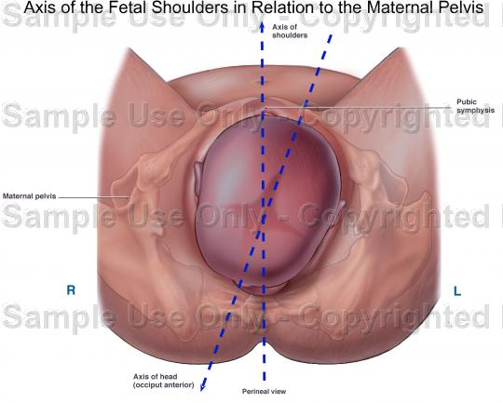
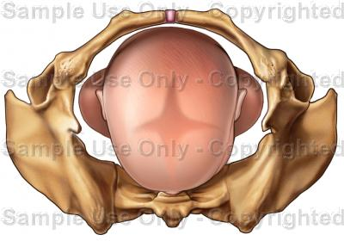

Slide 4
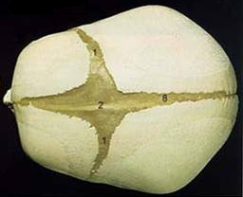
The FETAL SKULL is made of bones which forms the VAULT and the BASE.
VAULT is made of thin, compressible
And pliable flat bones.
BASE is made of rigid and incompressible bones.

Slide 5
The bones which forms the skull are –
- 2 Frontal bones
- 2 Parietal bones
- 2 Temporal bones
- The wings of sphenoid
- 1 Occipital bone

Slide 6
For the obstetrical importance, the fetal skull is divided into various areas like –
a. Vertex
b. Brow
c. Face
d. Occiput

Slide 7
Like that it poses SUTURES.
They are
- Frontal suture
- Sagittal suture
- Coronal sutures
- Lambdoid sutures
- Temporal sutures

Slide 8
Wide gap in the suture line is called
FONTANELLE. There are 6 fontanelles.
- Anterior fontanelle {bregma}
- Posterior fontanelle {lambda}
- Sagittal fontanelle
- Temporal [gasserian] fontanelles
Among them 1 & 2 has obstetric significance.

Slide 9
Areas
a. Vertex
b. Brow
c. Face
d. Occiput

Slide 10
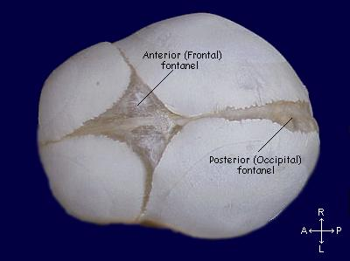
VERTEX is a diamond shaped area between the anterior & posterior fontenelles & the parietal eminences.
Boundaries
Ant – bregma & coronal sutures
Post – post fontenel & Lambdoid sutures
Lat - arbitrary lines through parietal bones.

Slide 11
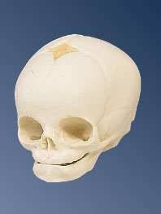
BROW lies between anterior fontanelle
[bregma] & coronal sutures till root of nose
& supra orbital ridges

Slide 12
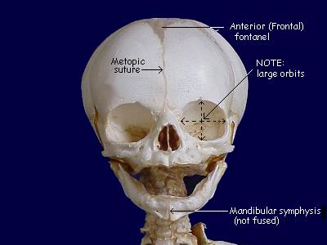
FACE lies between root of the nose, supra orbital ridges till the junction of the floor of the mouth with neck.

Slide 13
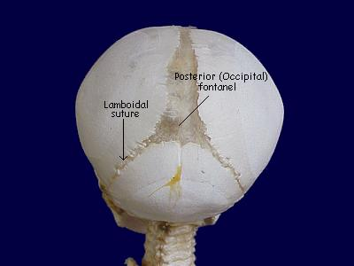
OCCIPUT is the bony prominance lies
behind the posterior fontanelle.
SUBOCCIPUT is the junction of foetal neck and occiput{nape of neck}

Slide 14
Sinciput – Fore head region of the foetal head.
Mentum - Chin
Sub Mentum – Junction between the neck & chin
Vertical point – Centre of sagital suture
Frontal point - Root of the nose

Slide 15
Sutures
- Frontal suture
- Sagittal suture
- Coronal sutures
- Lambdoid sutures
- Temporal sutures

Slide 16
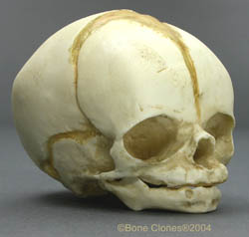
FRONTAL SUTURE is situated between the frontal bones.

Slide 17
SAGITTAL [longitudinal] SUTURE lies across the vault of the skull in the mid line between two parietal bones.

Slide 18
CORONAL SUTURE lies between parietal and frontal bones on eithar sides.
It separate both frontal & parietal bones.

Slide 19
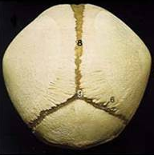
LAMBDOID SUTURE is seen between parietal & occipital bones.

Slide 20
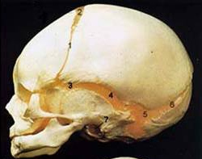
TEMPORAL SUTURES lies between inferior margin of parietal bone & temporal bone on eithar side.

Slide 21
Importents of sutures
It permits the gliding movement of one bone over the other during moulding of the head when the head passes through the pelvis during labour.
Digital palpation of sagital suture during labour gives clue to
- manner of engagement,(asynclitism, syncli)
- degree of internal rotation of head & - degree of moulding

Slide 22
FONTANELLE
- Anterior fontanelle {bregma}
- Posterior fontanelle {lambda}
- Sagittal fontanelle
- Temporal [gasserian] fontanelles
Among them only 1 & 2 has obstetric significance.

Slide 23
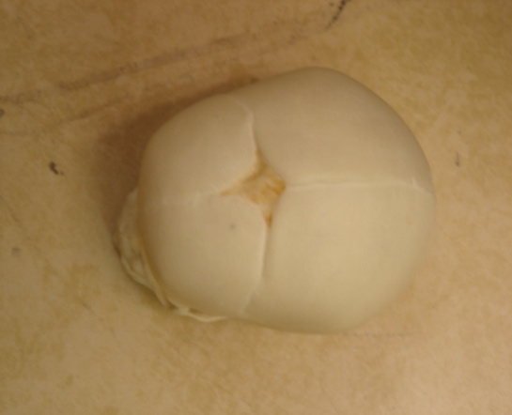
ANTERIOR FONTANELLE {bregma}
Formed by joining four sutures in the midline
Sutures are – Frontal, sagittal & coronal on sides
Shape - Diamond
Diameters - both AP & T diameters are approximately 3 cm
Floor - made of membranewhich ossifies
18 months after birth.
It denote the degree of flexion of head during P/V examination. It promote moulding of head during labour.

Slide 24
POSTERIOR FONTANELLE
{lambda}
Formed by joining 3 sutures.
Sutures – sagittal & lambdoid on either side
Shape - Triangular
Floor - membranous, but bony at term.
It denote the position of head in relation
to maternal pelvis.

Slide 25
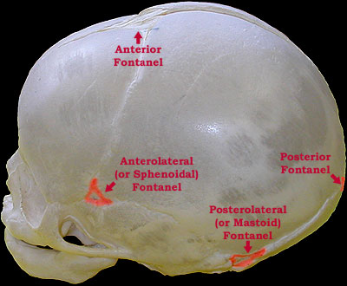
Sagittal fontanelle
Mostly it may not present. But if present,
It can occur on the sagital suture at the junction of ant 2/3 & post 1/3
- Temporal [gasserian] fontanelles

Slide 26
DIAMETERS OF SKULL

Slide 27
The engaging DIAMETERS OF SKULL
depend on the degree of flection present.
Antero posterior diameters are
a. Suboccipito bregmatic diameter
b. Suboccipito frontal diameter
c. Occipito frontal diameter
d. Mento vertical diameter
e. Submento vertical diameter
f. Submento bregmatic diameter
B. Transverse diameters are
a. Biparietal diameter
b. Super subparietal diameter
c. Bi-temporal diameter
d. Bi-mastoid diameter

Slide 28
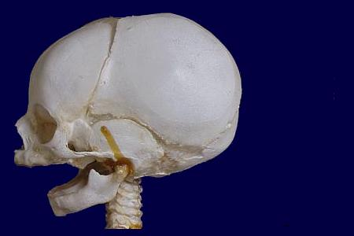
Antero posterior diameters
a. Suboccipito bregmatic
- 9.5cm {3 ¾”}
- Extend from nape of neck to the
centre of bregma
- Attitude of head is complete flection
- Presentation is vertex

Slide 29
b. Suboccipito frontal
- 10cm {4”}
- Extends from nape of the neck to
the mid point of frontal suture or [centre of sinciput]
- Attitude is incomplete flexion
- Presentation is vertex

Slide 30
c. Occipito frontal
- 11.5cm{4 1/2”}
- Extends from occipital eminence to the root of the nose [glabella ]
- Attitude of the head is marked deflection.
- Presentation is deflexed vertex.

Slide 31
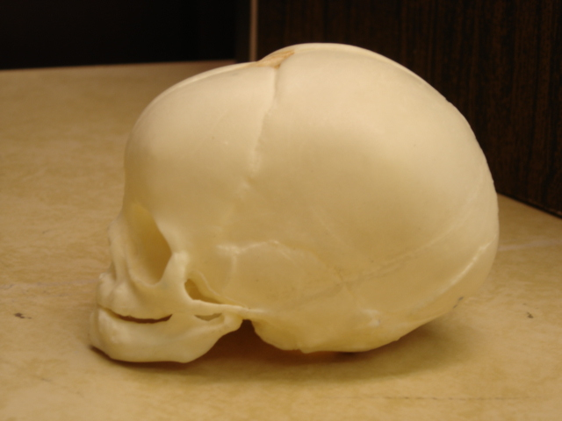
d. Mento vertical
- 14cm {5 1/2”}
Extend from chin to centre of the sagital suture
- Attitude of the head is partial extension
- Presentation is brow

Slide 32
e. Submento vertical
- 11.5cm {4 ½”}
- Extend from junction of floor of the mouth & neck to the highest point on the sagittal suture
- Attitude of the head is incomplete
extension
- Presentation is face

Slide 33
f. Submento bregmatic
- 9.5cm {3 ¾”}
- Extend from the chin to the middle of bregma
- Attitude of the head is complete extension
- Presentation is face

Slide 34
B. Transverse diameters are
a. Biparietal diameter
b. Super subparietal diameter
c. Bi-temporal diameter
d. Bi-mastoid diameter

Slide 35
a. Biparietal diameter
- 9.5 cm {3 3/4”}
- Extends between two parietal eminances

Slide 36
b. Super subparietal diameter
- 8.5 cm (3 ½”)
- Extends from a point placed below one parietal eminance to a point placed above the other parietal eminance of the opposite side.

Slide 37
c. Bi-temporal diameter
- 8 cm (3 ¼”)
- Between two lower ends of the coronal sutures.

Slide 38
d. Bi-mastoid diameter
- 7.5 cm (3”)
- Distance between the tips of the mastoid processes.
- It is an incompressible diameter.
- Impossible to reduce it’s length obstetrically.

Slide 39
Foetal head Circumference

Slide 40
Circumferences
Foetal head Circumference of vertex & face passes through the true pelvis .
This Circumference of Foetal head passes through the pelvis is the GIRDLE OF CONTACT.
True pelvis permits to pass various vertex or face presentations with GIRDLE OF CONTACT 9.4 – 11.25 cm.
But brow presentation (incomplete extension) with mento vertical diametre of 13 cm cannot pass through it.
Co the Circumference differs according to the attitude of head.

Slide 42
Attitude of the head | Plane of {Tr+Ap d} engagement | shape | Circumference in cm
Complete flexion | Biparital 9.5+ Subocc breg 9.5 | round | 27.5 (11”)
Deflexed | Biparital 9.5 + occi front 11.5 | oval | 34 cm (13 ½”)
Incomplete extension {brow} | Biparital 9.5 + ment vert 14 cm | Big oval | 37.5 cm (15”)
Complete extension | Biparital 9.5 + subment breg 9.5 | round | 27.5 cm (11”)

Slide 43
Clinical importance of sutures & fontanelles
Palpation of sagittal suture with fontanelles in labour can identify the attitude & position of vertex in Vertex presentation.
Overlapping of cranial bones signifies the moulding of head.
extreme Overlapping in labour denotes foetal death.

Slide 44
Presenting parts of Foetal skull
Vertex
Face
brow

Slide 45
Foetal skull changes in labour
Moulding
Caput succedaneum

Slide 46
Moulding
It is the alteration of the shape of the fore coming head with minimal reduction in size due to resistance of girdle of contact while passing through the resistant birth passage during labour.
Alteration of head with minimal reduction in size of 4 mm in skull diameter is common in normal delivary.
Moulding disappears within few hours after birth.

Slide 47
Mechanism –
There is compression of the engaging diameter of the head with corresponding elongation of the diameter at Rt angle to it.
Girdle of contact

Slide 48
Gradings
There are 3 grades
Grade I - bones touching but not overlapping
Grade II - overlapping but easily seperated
Grade III - fixed overlapping

Slide 49
Caput succedaneum
It is the formation of swelling due to stagnation of fluid in the layers of the scalp beneath the girdle of contact.
Girdle of contact can be either
bone
dilating cervix or
vulval ring
Swelling is boggy, diffuse & not limited to the suture lines.
It appears after rupture of the membranes.
With increasing flexion, the caput is placed more posteriorly.
It disappears spontaneously within 24 hrs of birth.

